Slide 1
GREEK POLIS
SEM –I
CC-II
MOUSUMI ROY CHOUDHURY

Slide 2
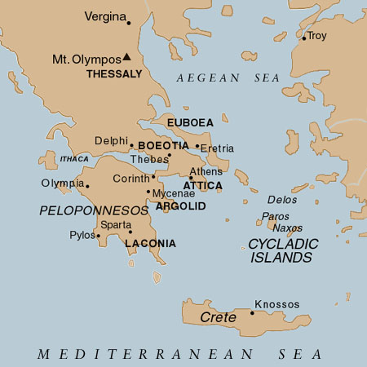

Slide 3
Greek city-states
800s/700s BC – formed independent city-states (polis)
Concept of a polis:
  city (fort) and surrounding territory
  community (people)
  politically and economically independent

Slide 4
How city-states (poleis) were alike:
1. Covered small area
2. Populations of fewer than 10,000 (mostly slaves)
3. Fort built on acropolis (hill)
4. Had an agora (marketplace, public meeting place)

Slide 5
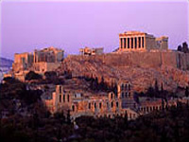
Acropolis
In Greek, Acropolis means "Highest City". For purposes of defense, early settlers naturally chose elevated ground. The most famous example is the Acropolis of Athens which is known as the Acropolis. It contains the famous Parthenon, built as a temple to the Greek goddess Athena.

Slide 6
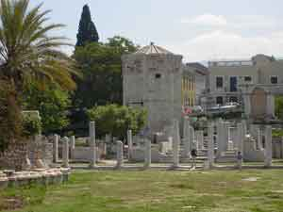
Agora
The ruins of the Agora, the commercial center of ancient Athens.

Slide 7
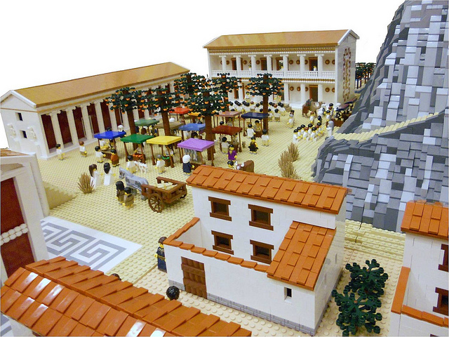

Slide 8
5. Greeks had loyalty to polis
6. People from all poleis spoke Greek
7. All saw non-Greeks as barbarians
8. Shared many religious, cultural, and social characteristics

Slide 9
How city-states were different:
Each had its own:
  Government
  Laws
  Calendar
  Money
  Weights and measures

Slide 10
THANK YOU

